Slide 1
Computing Basics for Genomic Analysis
January 28, 2013

Slide 2
Schedule
Start | End | Topics
9:00:00 | 9:30:00 | Registration and Overview
9:30:00 | 10:30:00 | Genomic Data Files
10:30:00 | 11:30:00 | Unix Basics 1 - Server and commands
11:30:00 | 12:30:00 | Unix Basics-2 – Shell scripting
12:30:00 | 13:30:00 | Lunch
13:30:00 | 14:45:00 | R basics
14:45:00 | 15:00:00 | Break
15:00:00 | 16:30:00 | R visualization and example
16:30:00 | 17:00:00 | NGS applications

Slide 3
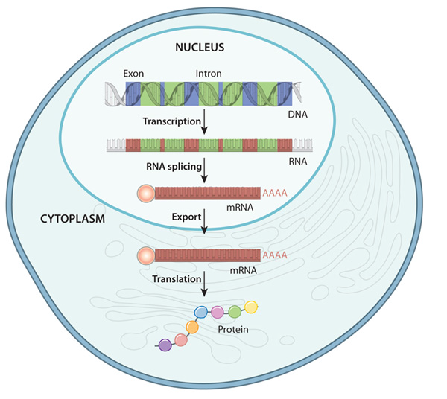
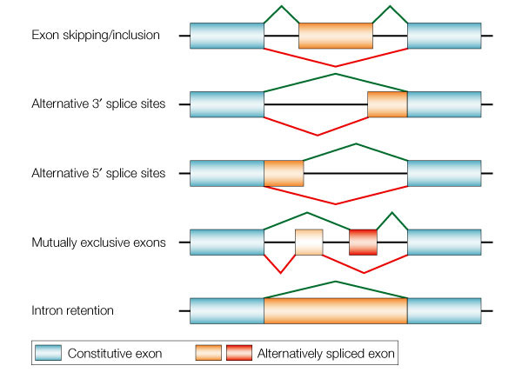
Central Dogma of Molecular Biology
Cartegni et al, Nature Reviews Genetics, (2002)
Notes:
Cartegni,
L.,
Chew,
S.
L.,
&
Krainer,
A.
R.
Listening
to
silence
and
understanding
nonsense:
exonic
muta8ons
that
affect
s
Nature
Reviews
Gene/cs3,
285–298
(2002)

Slide 4
What initial questions do we want to answer using genomic data?
Which genes are expressed?
Which genes are differentially expressed among the groups?
Do my favorite genes/pathways become up/down-regulated?
Can we detect RNA isoforms? Novel ones?
What are the genomic regions with copy number variations?
Can we detect structural variants? SNPs, insertions, deletions, RNA-editing?
What are the TF binding sites?

Slide 5
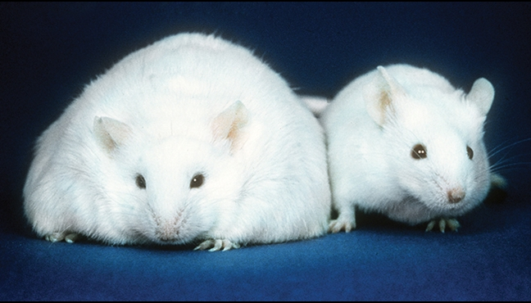
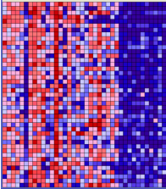
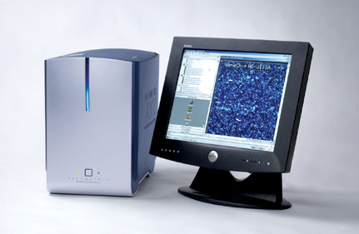
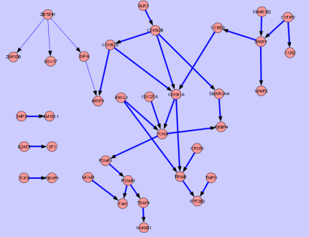
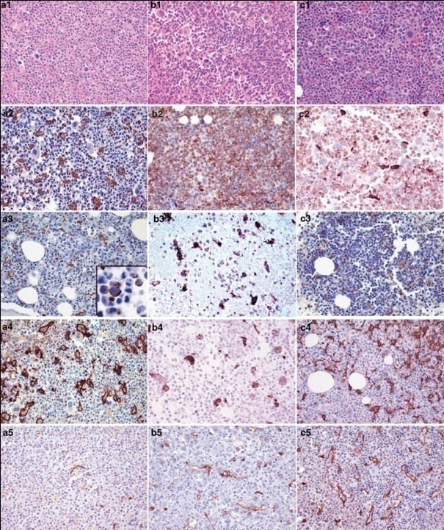
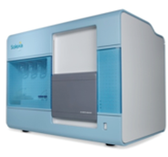
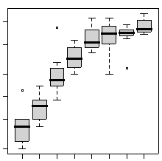
Genomics Research
Microarray
NGS

Slide 6
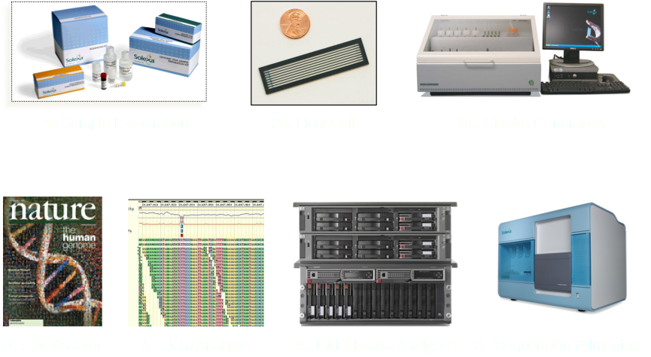
Next-Generation Sequencing Workflow

Slide 7
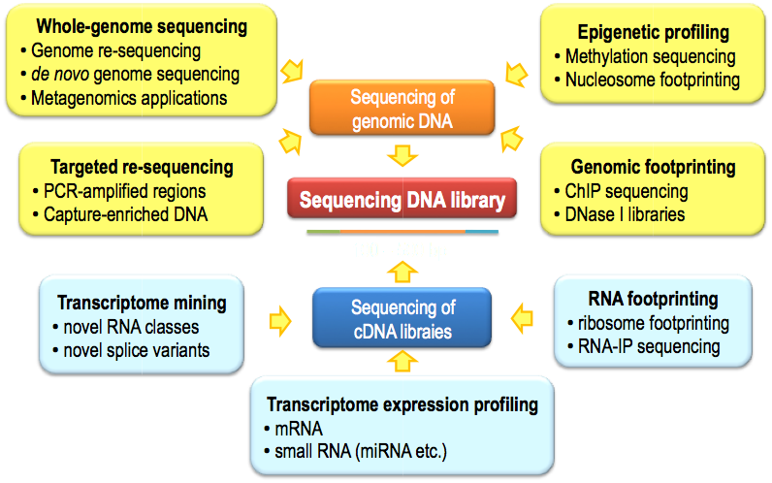
Applications of Next-Generation Sequencing

Slide 8
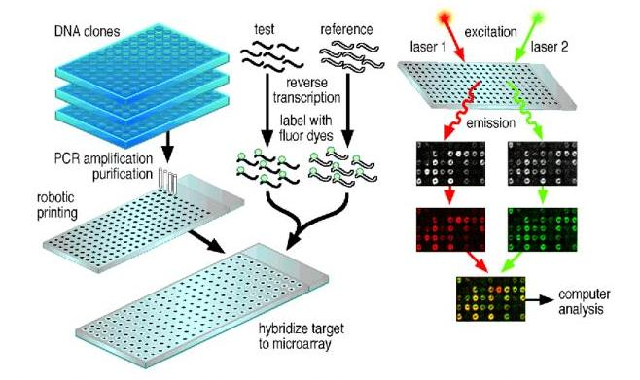

Microarray Experiment Flow

Slide 9

Data Generation Pipeline-NGS
Array Experiment
Output Image
Normalization
CEL file

Slide 10
Data Generation Pipeline-Microarray
Imaging Processing
Base calling
Genome Alignment
Fastq
@SRR001666.1 071112_SLXA-EAS1_s_7:5:1:817:345 length=36 GGGTGATGGCCGCTGCCGATGGCGTCAAATCCCACC

Slide 11
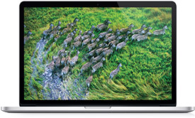
Data Analysis- Individual Sample Data is huge
Per human sample
Platform | Exome/aCGH | Transcriptome | ChIP
Micoarray | ~115 MB | ~13-40 MB | ~60 MB
HiSeq Run | ~67.5-135 GB | ~33.75-67.5 GB | ~13.5-20 GB
For 20 human sample
Platform | Exome/aCGH | Transcriptome | ChIP
Micoarray | ~2 Gb | ~260 MB | ~1.2 MB
HiSeq Run | ~1350 GB | ~680 GB | ~270 Gb
Price | $2,799
Processor | 2.6GHz, quad-core
Memory | 16 GB
Storage | 768 GB
MacBook Pro

Slide 12
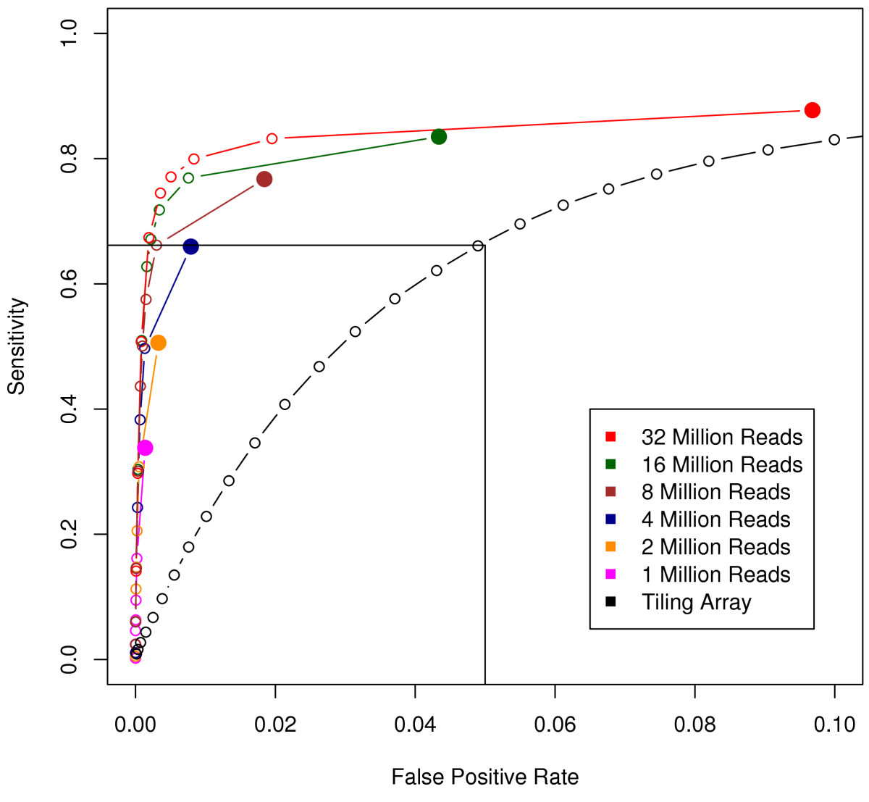
Comparison of transcriptome profile from RNA-Seq and tiling arrays using qPCR as gold standard
RNASeq 6-plex
RNASeq 11-plex
Microarray
Maximum
Sensitivity
RNA-Seq and tiling arrays
Tiling Array
Agarwal, BMC Genomics (2010)
Notes:
ROC curve analysis. Black: tiling array. Red: RNA-Seq with all 32 million reads. It is evident that the RNA-Seq substantially outperforms the tiling array with consistently higher sensitivity at lower FPR. Remaining curves are for RNA-Seq with only a subset of reads utilized. At an FPR = 0.05, just 4 million reads (blue) are required to attain the same sensitivity as two tiling array replicates.

Slide 13
Microarray and RNASeq Comparison
Microarray is cheaper?

Slide 14
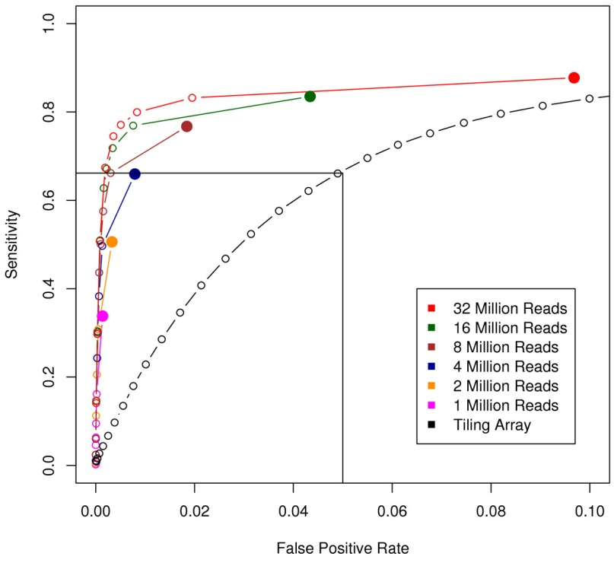
RNASeq v.s. Microarray Cost Analysis
Per Sample | Microarray | Illumina HiSeq
1 per Chip/Lane | $670 | $4,010.00
2 plex | NA | $2,097.50
4-plex | NA | $1,141.25
6-plex | NA | $822.50
8-plex | NA | $663.13
11-plex
6-plex

Slide 15
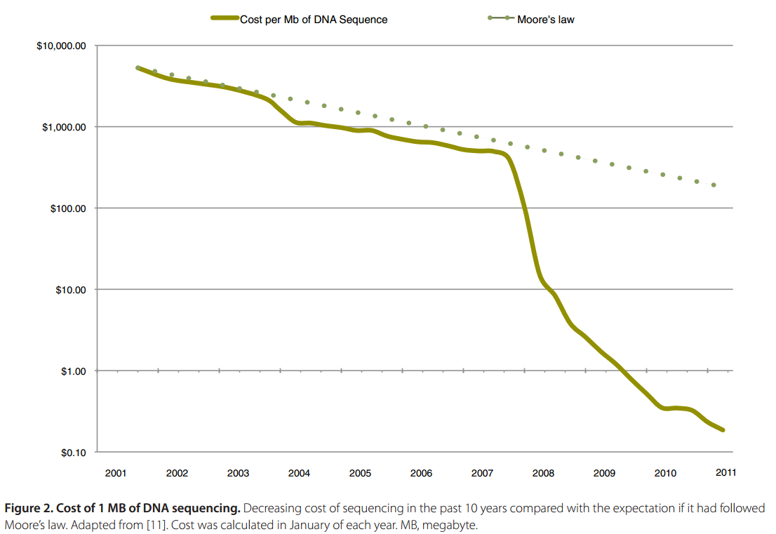
RNASeq v.s. Microarray Cost Analysis
Per Sample | Microarray | Illumina HiSeq
1 per Chip/Lane | $670 | $4,010.00
2 plex | NA | $2,097.50
4-plex | NA | $1,141.25
6-plex | NA | $822.50
8-plex | NA | $663.13

Slide 16
Microarray and RNASeq Comparison
RNASeq is cheaper?

Slide 17
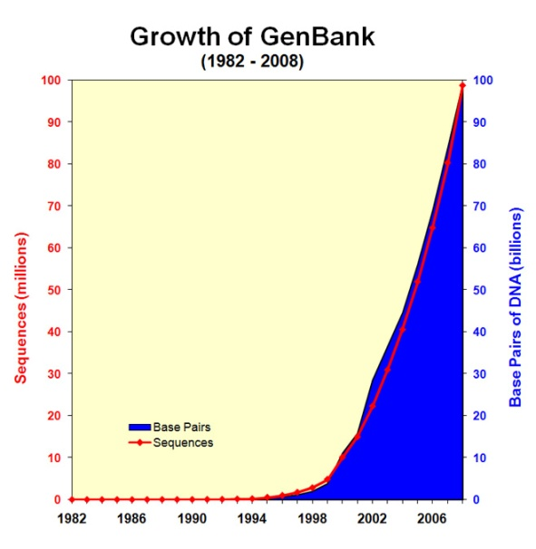
Microarray v.s. RNASeq: Big Data Challenge
 | Data Per Sample | Time to download 1 Sample | Time to download 100 samples | Cost to Store on the Cloud per Month
RNASeq | 30-65GB | 1 Hr | 6 days | $270
Microarray | 30MB | 5 second | 8 minutes | $0.30
http://www.ncbi.nlm.nih.gov/genbank/statistics

Slide 18
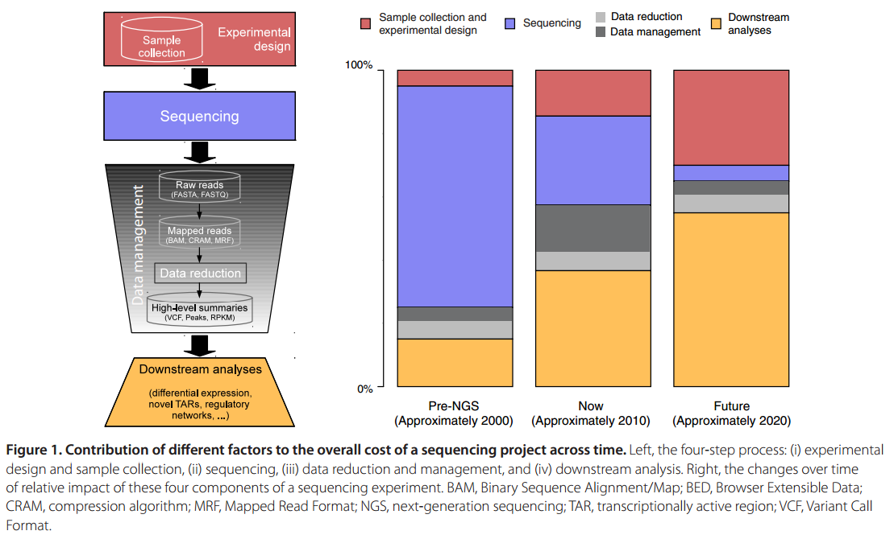

Bioinformatics will become the single largest cost in sequencing

Slide 19
Genomics Data analysis is a job for computer Cluster
Group of independent systems that
Function as a single system
Appear to users as a single system
And are managed as a single system’
Clusters are “virtual servers”

Slide 20
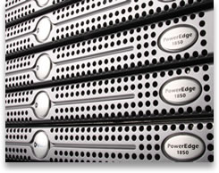
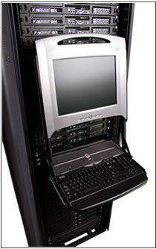
The cluster is a stack of “rack mount” servers a bit like pizza boxes

Slide 21
Cluster Resources on Longwood Campus
Partners Research Computing
http://rc.partners.org
Research IT Group of HMS
http://ritg.med.harvard.edu/
Research Computing at DFCI
http://research4.dfci.harvard.edu/
Amazon Cloud Computing

